Slide 1
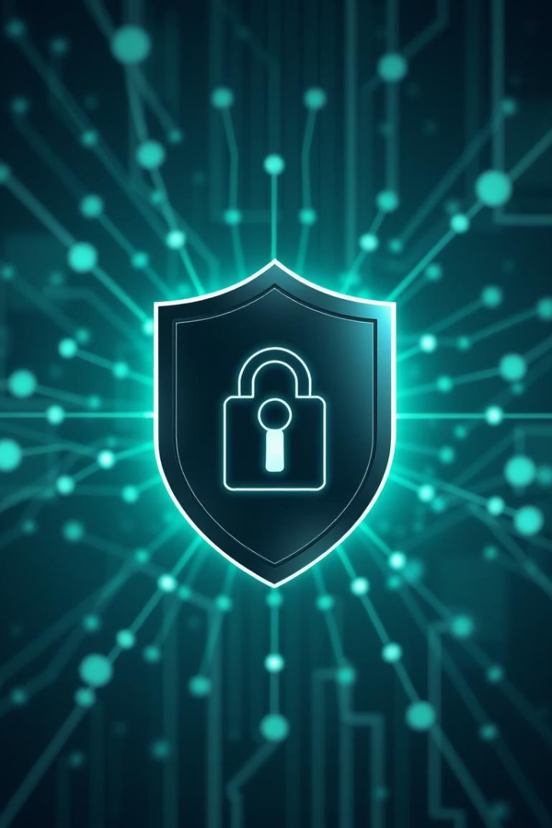

Phishing Awareness Training
Welcome to our Phishing Awareness Training. This session, presented by Devang Kumar, aims to equip you with the knowledge and skills to identify and protect yourself from online phishing scams. Your vigilance is key to maintaining a secure digital environment for everyone.
by Devang Kumar

Slide 2
What is Phishing?
Phishing is a deceptive cybercrime where attackers impersonate trustworthy entities in electronic communication to steal sensitive data. This often includes usernames, passwords, credit card details, and other personal information. According to Verizon’s Data Breach Investigations Report, phishing remains a top threat, accounting for a significant percentage of all data breaches. Understanding what phishing is, and how prevalent it is, is the first step in protecting yourself and our organization.
Fraudulent Attempts
Impersonation
Data Theft
Attackers use fake emails or messages to trick individuals into revealing sensitive information.
Phishers often pretend to be legitimate organizations, such as banks, social media platforms, or even internal IT departments.
The ultimate goal is to obtain confidential data like login credentials, financial details, or personal identifiable information (PII).

Slide 3




How Phishing Works: The Bait, The Hook, The Catch
Phishing attacks typically follow a three-stage process, designed to exploit human trust and urgency. Understanding these stages can help you recognize an attack in progress and prevent falling victim to it.
The Bait
Attackers send a deceptive email or message, often masquerading as a trusted source, to pique your curiosity or create a sense of urgency.
The Hook
You are enticed to click a malicious link, open an infected attachment, or reply with sensitive information.
The Catch
Unknowingly, you provide your sensitive data on a fake website or directly to the attacker, leading to a compromise of your accounts or personal information.

Slide 4




Social Engineering: Manipulating Human Psychology
Phishers are masters of social engineering, employing psychological tactics to bypass our rational defenses. They exploit natural human tendencies and emotions to trick even the most vigilant users. These tactics are highly effective because they tap into our primal responses, making us act quickly without critical thought.
Curiosity
Luring you with intriguing but fake offers or sensational news.
Trust
Impersonating known brands, colleagues, or authorities to gain your confidence.
Urgency
Pressuring you with immediate threats or time-sensitive opportunities to force quick action.
Fear
Threatening consequences, such as account suspension or legal action, to induce panic.
A staggering 97% of users fail to recognize sophisticated phishing scams, highlighting the critical need for continuous awareness and training. Understanding these manipulation techniques is crucial to avoid becoming a victim.

Slide 5





Spotting Phishing Emails: Red Flags
Phishing emails often contain telltale signs that can help you identify them. By carefully examining incoming messages, you can significantly reduce your risk of falling victim. Train your eye to spot these red flags, and always err on the side of caution when something feels off.
Generic Greetings
Poor Grammar/Spelling
Suspicious URLs
Instead of using your name, they might use "Dear Customer" or similar non-personal salutations.
Legitimate organizations typically proofread their communications; errors are a major red flag.
Hover over links to see the actual URL. If it doesn't match the sender's known domain, it's likely a scam.
Mismatched Sender Addresses
Threatening Language
The "From" name might seem legitimate, but the actual email address will reveal a different, often suspicious, domain.
Messages demanding immediate action or threatening negative consequences (e.g., account suspension) are common phishing tactics.

Slide 6
Fake Websites: A Closer Look
Once you click a malicious link, you're often redirected to a fake website designed to look exactly like a legitimate one. These sites are crafted to trick you into entering your credentials or personal information. Learning to identify these imposters is as crucial as spotting phishing emails.
Lookalike Domains & Typos
Inconsistent Branding
Phishers often use URLs that are very similar to the real ones, with subtle misspellings (e.g., "gooogle.com") or extra words (e.g., "amazon-login.com"). Always double-check the URL in your browser's address bar.
While often good, fake sites might have slight variations in logos, fonts, or overall design compared to the real site.
Requests for Excessive Information
Missing HTTPS & Security Indicators
If a website suddenly asks for unusual or excessive personal details (e.g., your mother's maiden name, pet's name, and favorite color all at once), it's a major red flag.
Legitimate websites, especially those requesting personal information, always use HTTPS (indicated by a padlock icon in the browser). If it's missing or shows an error, be suspicious.
Phishing attacks can have devastating financial consequences for businesses, with small businesses alone losing millions annually. Vigilance against fake websites is a critical defense.

Slide 7


Real-World Phishing Examples
Understanding real-world incidents helps illustrate the severe impact of phishing attacks. These examples demonstrate that phishing isn't just about losing personal data; it can disrupt critical infrastructure, cause massive financial losses, and damage reputations on a global scale.
Colonial Pipeline Attack (2021)
A single compromised password, likely obtained through a phishing scam, led to the shutdown of the largest fuel pipeline in the US. This resulted in widespread fuel shortages, panic buying, and a multi-million dollar ransom payment, highlighting the vulnerability of critical infrastructure to phishing.
Ubiquiti Networks Hack (2021)
Attackers used phishing to steal credentials and impersonate employees, gaining access to sensitive corporate data. This incident not only led to a significant financial hit and reputational damage but also exposed the importance of robust internal security protocols and employee awareness against sophisticated social engineering.

Slide 8
Prevention: Stay Safe Online
While phishing attacks are sophisticated, there are concrete steps you can take to protect yourself. Implementing these preventative measures significantly reduces your risk of falling victim and helps maintain a secure digital environment for everyone.
Hover Over Links
Before clicking, always hover your mouse over a link to preview the actual URL. If it looks suspicious or doesn't match the expected destination, don't click.
Enable Two-Factor Authentication (2FA)
2FA adds an extra layer of security, requiring a second verification method (like a code from your phone) in addition to your password. This makes it much harder for attackers to access your accounts even if they steal your password.
Verify Sender Identity
If an email seems suspicious, especially if it asks for sensitive information or urgent action, contact the sender directly through a known, legitimate channel (e.g., phone number from their official website, not from the email itself) to verify.
Keep Software Updated
Regularly update your operating system, web browsers, and antivirus software. Updates often include critical security patches that protect against known vulnerabilities exploited by phishers.
Report Suspicious Emails
If you receive a phishing email, report it to your IT or security team immediately. Do not delete it until instructed, as it can provide valuable information for defense.

Slide 9
Phishing Quiz: Test Your Knowledge
It's time to put your phishing awareness to the test! Answer the following multiple-choice questions to see how well you can identify and understand phishing tactics. Choose the best answer for each question.
Question 1: What is the primary goal of phishing?(a) To deliver malware(b) To steal personal information(c) To improve website traffic
Question 2: Which of these is a sign of a phishing email?(a) Personalized greeting(b) Urgent request(c) Proper grammar
Question 3: What is 2FA?(a) Two Factor Authentication(b) Top financial advice(c) A type of virus
Answers: 1(b), 2(b), 3(a)
1
2
3
Question 1
Question 2
Question 3
The primary goal is to steal personal information.
An urgent request is a common phishing tactic.
2FA stands for Two Factor Authentication.

Slide 10
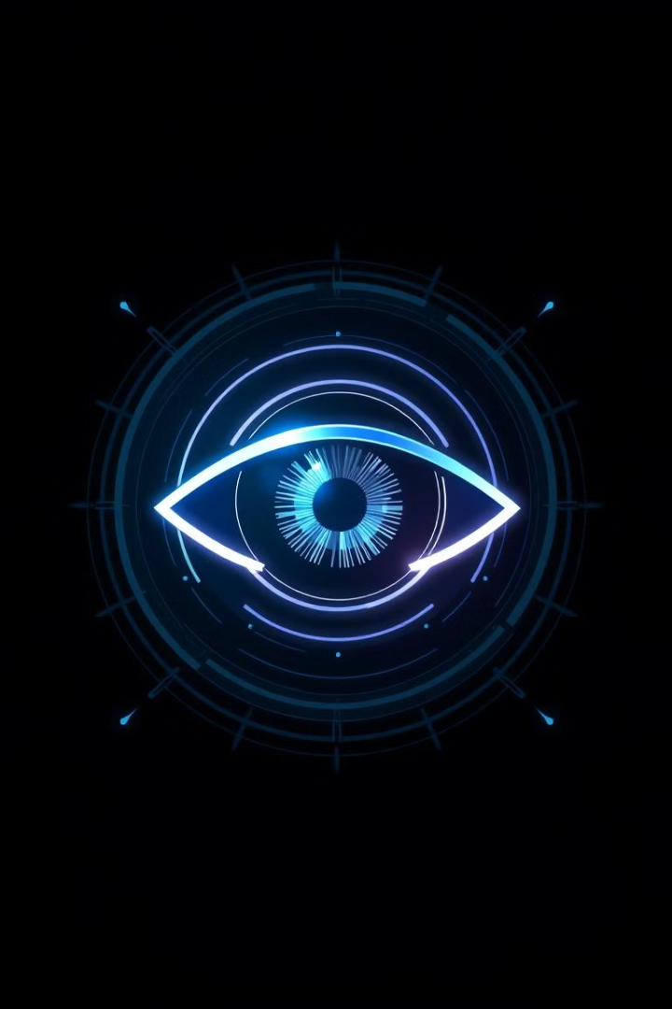



Stay Vigilant, Stay Safe!
As we conclude this training, remember that the digital threat landscape is constantly evolving. Phishing attacks are becoming more sophisticated, making continuous education and unwavering vigilance absolutely critical. Your active awareness is the strongest defense against cyber threats. Be proactive, be suspicious, and never hesitate to report anything that seems out of place.
Your role in identifying and reporting suspicious activity is paramount. By working together and staying informed, we can build a stronger, more secure digital environment for everyone. Thank you for your attention and commitment to online safety.
Report Suspicious Activity
Be Your Own Firewall
Stay Informed

